Slide 1
BRAIN TUMOR CLASSIFICATION AND PREDICTION USING CONVOLUTION-AL NEURAL NETWORKS
CAPSTONE PROJECT THREE
DATA SCIENCE CAREER TRACK
SPRINGBOARD
SHAHJAHAN AHMED
JANUARY 02, 2022

Slide 2
Problem Statement
Brain Tumor Classification and Prediction using Convolutional Neural Networks to help automate the diagnostic process which will ensure proper treatment and save lives and resources.

Slide 3
Introduction
A brain tumor is a collection, or mass of abnormal cells in our brain. Our skull, which encloses our brain, is very rigid. Any growth inside such a restricted space can cause problems.
Brain tumors can be cancerous (malignant) or noncancerous (benign). When benign or malignant tumors grow, they can cause the pressure inside our skull to increase. This can cause brain damage, and it can be life-threatening.
Early detection and classification of brain tumors is an important research domain in the field of medical imaging and accordingly helps in selecting the most convenient treatment method to save patients life.

Slide 4
Stakeholders
Doctors
Hospitals
Medical Centers
Patients

Slide 5
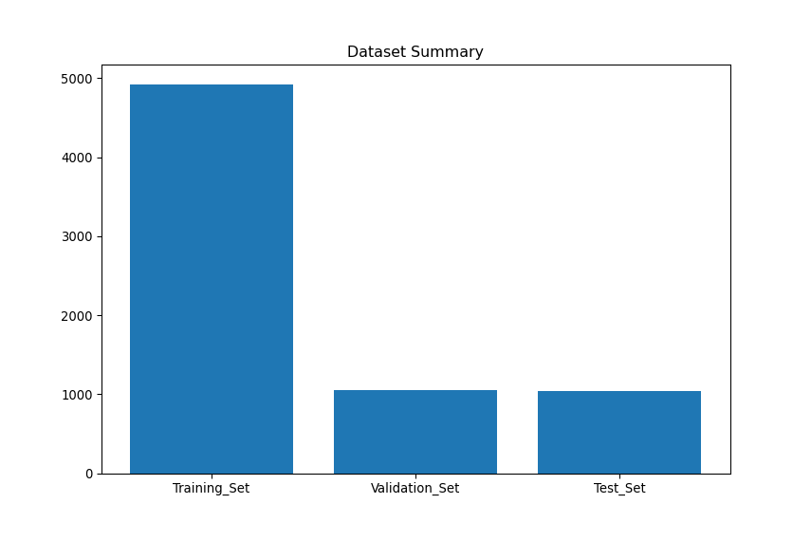
Dataset Summary
The dataset contains four separate classes of brain MRI images: Glioma Tumor, Meningioma Tumor, Pituitary Tumor, and Absence of Tumor.
The total number of images is 7023 and I have divided them into training set, validation set, and test set with a 70:15:15 ratio.
Each of the training, validation, and test dataset contains all four MRI image classes.

Slide 6
Brain Tumor Classes
Glioma Tumor:
Glioma is a type of tumor that occurs in the brain and spinal cord.
Gliomas are the most prevalent type of adult brain tumor, accounting for 78 percent of malignant brain tumors.
Pituitary Tumor:
A pituitary tumor is an abnormal growth in our pituitary gland. It is located behind the back of the nose.
It makes hormones that affect many other glands and many functions in your body.
Most pituitary tumors are not cancerous (benign).
Meningioma Tumor:
Meningioma is the most common primary brain tumor, accounting for more than 30% of all brain tumors.
Meningiomas originate in the meninges, the outer three layers of tissue that cover and protect the brain just under the skull.
About 85% of meningiomas are noncancerous, slow-growing tumors.
No Tumor:
The MRI image does not contain any kinds of tumor cell.

Slide 7
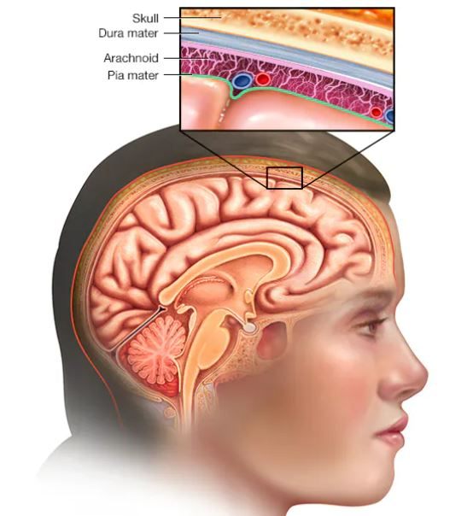
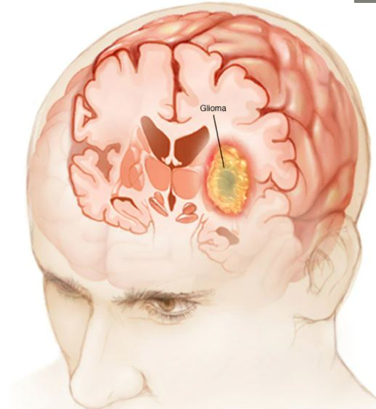
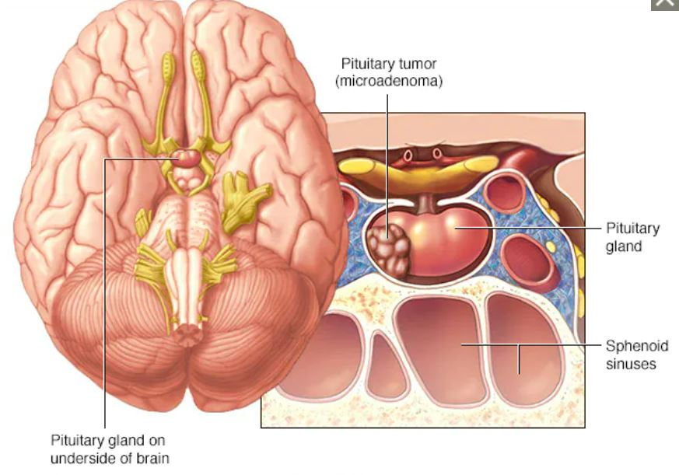
Brain Tumor Classes

Slide 8
Data Wrangling
Imported dataset from Kaggle.com
Manually divide them in training, validation, and test sets.
Observed all the MRI images in training, validation, and test set with their respective file format.
Observed whether the dataset contain RGB or grayscale images.
Applied different filtering techniques to improve the image quality.
Observed the shape of each images in training, validation, and test set for resizing.
Converted all the images into gray scale image of size (128, 128, 1).

Slide 9
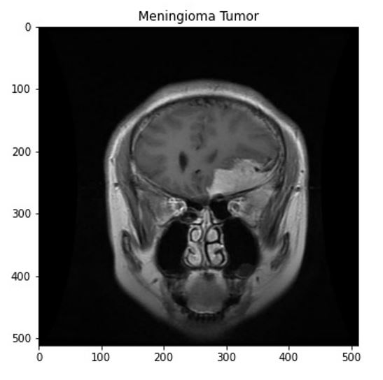
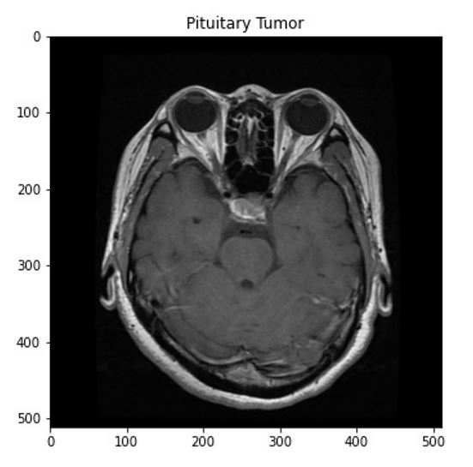
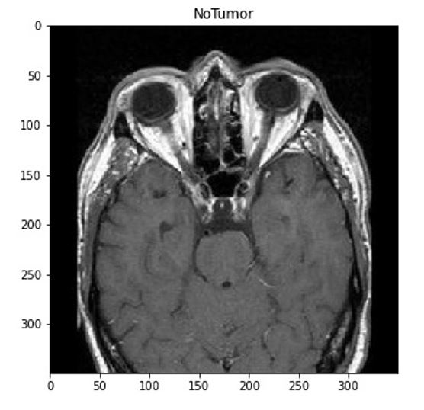
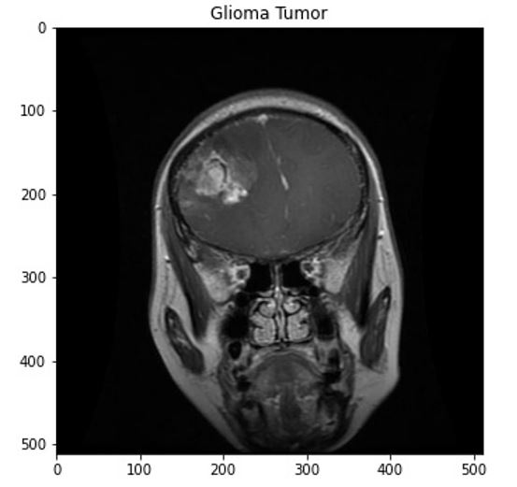
Exploratory Data Analysis Step one
The dataset contains RGB image with different shapes.
There are four tumor classes in each training, validation, and test set.
The figure below depicted the MRI images of four different tumor classes.

Slide 10
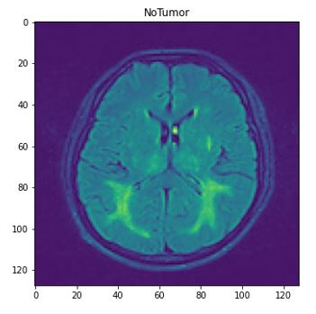
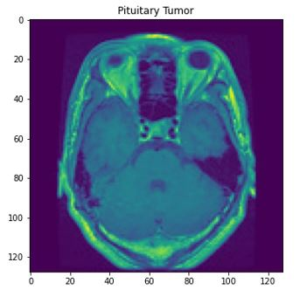
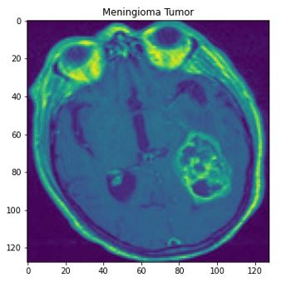
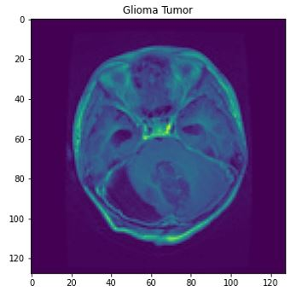
Exploratory Data Analysis Step two
Applied some filtering techniques.
RGB to grayscale conversion
Figure below shows the resized images of shape (128,128,1).

Slide 11
Preprocessing
Created image arrays and corresponding labels for training, validation, and test dataset.
The image arrays are respectively X_train, X_valid, and X_test, and the corresponding labels for image arrays are y_train, y_valid, and y_test.
Created one-hot vectors for y_train, y_test, and y_valid

Slide 12
Modeling Steps
Implement different Neural Network Architectures for Brain Tumor Classification and Prediction
Started with small network, then gradually increased the capacity, and kept increasing the capacity until reaches my computational limitations.
Tried to use Google Colab for model fitting.
Tried to use transfer learning also.
Set up appropriate hyperparameters for each model
Compile each model using appropriate optimizer, loss function, and model metrics
Train each model using training set and predict the model’s performance using test set
Evaluate test results of each model using evaluation metrics
Compare and find the best model

Slide 13
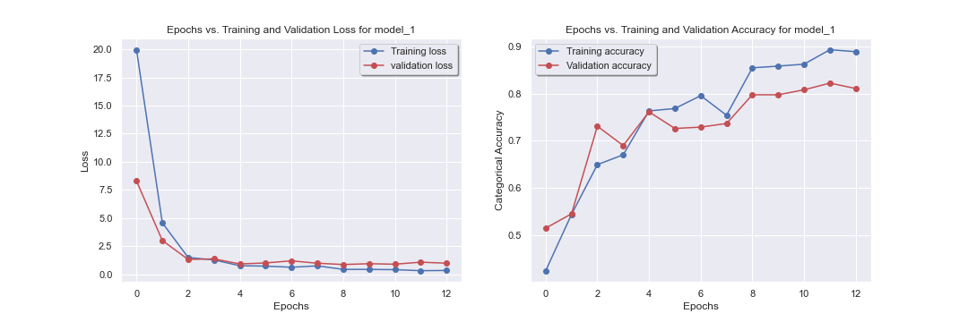
Model 1: Simple neural network with only dense layers
The model 1 contains an input layer, six Dense layers, and one output layer.
I have used ‘ReLU’ as an activation function for the Dense layers and ‘softmax’ as an activation function for the output layer
I have defined Adam as an optimizer, categorical accuracy as a loss function, categorical cross entropy as a model metric.
No Regularization techniques used.
Did not find the complex pattern in the data. There was not training and validation progress at certain epochs/steps. Need to implement complex models.

Slide 14
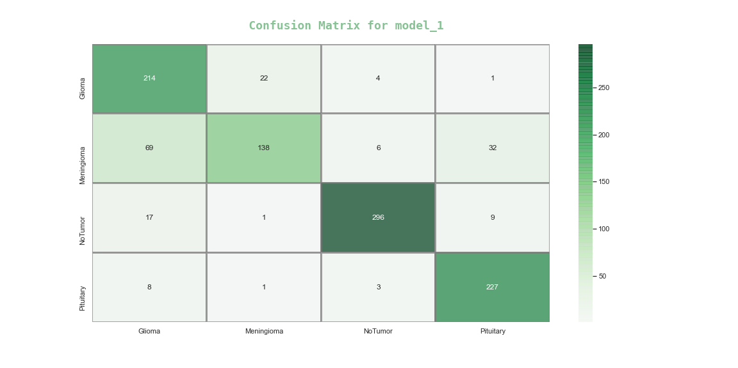
Evaluation Results for Model 1
Training Accuracy: 0.893
Validation Accuracy: 0.822
Test Accuracy: 0.834
Precision Score: 0.85
Recall Score: 0.83
F1 Score: 0.83

Slide 15
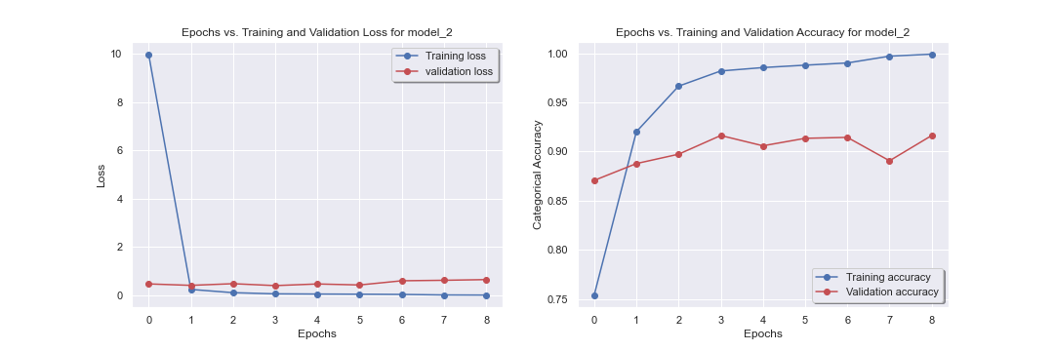
Model 2: Convolutional neural network with two Conv2D layers
Model 2 contains an input layer, two Conv2D layers with MaxPolling2D layer, one Dense layer, and an output layer.
I have used ‘ReLU’ as an activation function for the hidden layers and ‘softmax’ as an activation function for the output layer
I have defined Adam as an optimizer, categorical accuracy as a loss function, categorical cross entropy as a model metric.
No Regularization technique used.
Did not generalize well due to overfitting.

Slide 16
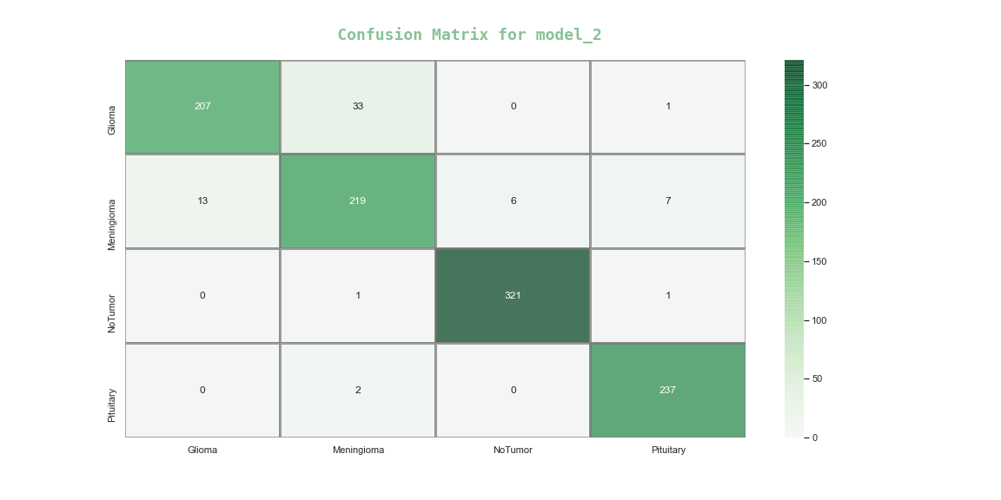
Evaluation Results for Model 2
Training Accuracy: 0.999
Validation Accuracy: 0.916
Test Accuracy: 0.938
Precision Score: 0.94
Recall Score: 0.94
F1 Score: 0.94

Slide 17
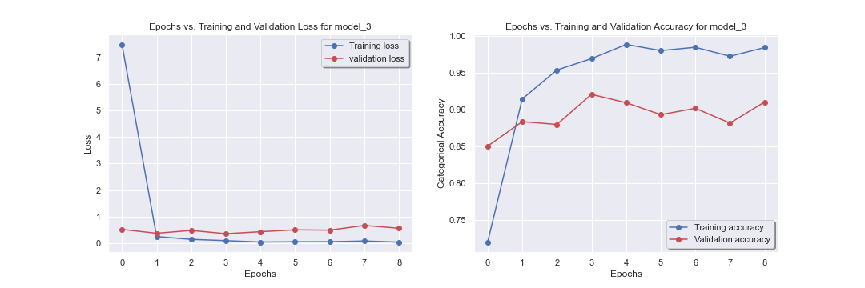
Model 3: Convolutional neural network with two Conv2D layers and an addition of regularization layers
Model 3 is a copy of model 2 with some additional regularization techniques.
To overcome the overfitting caused by model 2, I have added BatchNorm2D layer after each convolutional layers and a Dropout layer after the dense layer.
The optimizer, loss function, model metrics have kept same with previous model.
Still contain overfitting and did not capture the complex patters in the data due to model’s capacity.

Slide 18

Evaluation Results for Model 3
Training Accuracy: 0.988
Validation Accuracy: 0.921
Test Accuracy: 0.932
Precision Score: 0.93
Recall Score: 0.93
F1 Score: 0.93

Slide 19
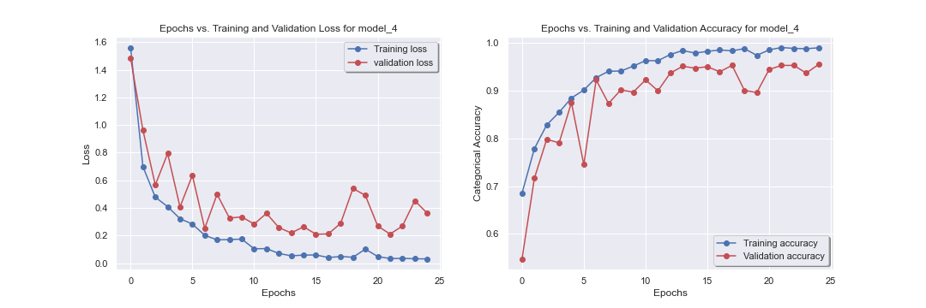
Model 4: Convolutional neural network with three Conv2D layers and regularization layers
Model 4 contains an input layer, three Conv2D layers with MaxPolling2D and BatchNorm2D layers, two Dense layers, and an output layer.
The activation function, optimizer, loss function, and model metrics remains same with previous models.
Additionally, I have introduced learning rate scheduling and EarlyStopping for adaptive training.
BatchNorm2D, and Dropout layers used for regularization.
Model’s performance increased by increasing model’s capacity.

Slide 20
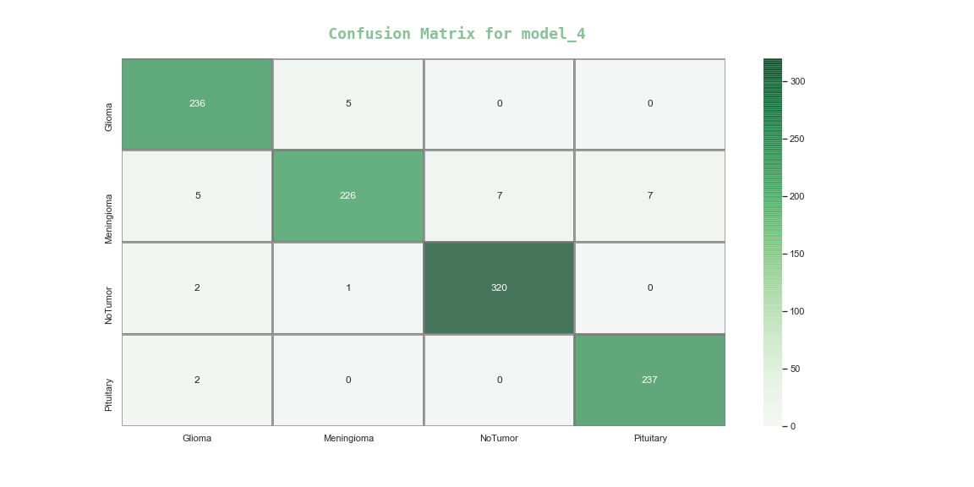
Evaluation Results for Model 4
Training Accuracy: 0.990
Validation Accuracy: 0.955
Test Accuracy: 0.972
Precision Score: 0.97
Recall Score: 0.97
F1 Score: 0.97

Slide 21
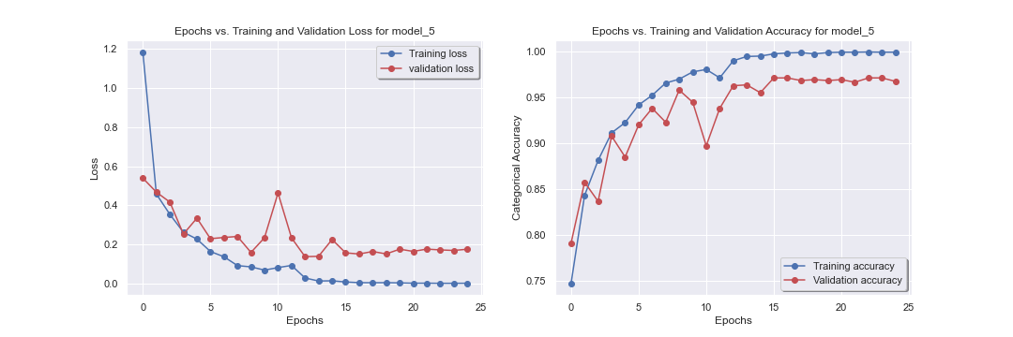
Model 5: Convolutional neural network with four Conv2D layers and regularization layers
Model 5 contains an input layer, four Conv2D layers with MaxPolling2D and BatchNorm2D layers, one Dense layer, and an output layer.
The activation function, optimizer, loss function remains same with previous models.
I have introduced learning rate scheduling and EarlyStopping for adaptive training.
BatchNorm2D, and Dropout layers for regularization
Model shows optimum performance.
Did not add more Conv2D layers due to computational limitations.
Performed hyperparameter tuning on model5 to check more accuracy. Did not receive any improvement.

Slide 22

Evaluation Results for Model 5
Training Accuracy: 0.99
Validation Accuracy: 0.972
Test Accuracy: 0.981
Precision Score: 0.98
Recall Score: 0.98
F1 Score: 0.98

Slide 23
Results and Findings
Model 1 results training accuracy of 0.893, validation accuracy of 0.822, and test accuracy of 0.834. The weighted value of precision, recall, and F1-score is 0.85, 0.83, and 0.83, respectively.
Model 2 results training accuracy of 0.999, validation accuracy of 0.916, and test accuracy of 0.938. The weighted value of precision, recall, and F1-score is 0.94.
Model 3 results training accuracy of 0.988, validation accuracy of 0.921, and test accuracy of 0.932. The weighted value of precision, recall, and F1-score is 0.93.
Model 4 results training accuracy of 0.990, validation accuracy of 0.955, and test accuracy of 0.972. The weighted value of precision, recall, and F1-score is 0.97.
Finally, the optimum model (model 5) results training accuracy of 99.9%, validation accuracy of 97.1%, and test accuracy of 98.1%. The weighted value of precision, recall, and F1-score is 98%.

Slide 24
Table showing the comparison among all Models Outcome
 | Training accuracy | Validation Accuracy | Test Accuracy | Weighted Average
 |  |  |  | Precision | Recall | F1-Score
Model 1 | 0.89 | 0.822 | 0.834 | 0.85 | 0.83 | 0.83
Model 2 | 0.99 | 0.916 | 0.938 | 0.94 | 0.94 | 0.94
Model 3 | 0.98 | 0.921 | 0.932 | 0.93 | 0.93 | 0.93
Model 4 | 0.99 | 0.955 | 0.972 | 0.97 | 0.97 | 0.97
Model 5 | 0.99 | 0.972 | 0.981 | 0.98 | 0.98 | 0.98

Slide 25
Conclusion
Despite lack of proper computational resources, I have implemented, trained, and tested all my models and obtained good evaluation results.
The optimum model (model 5) results training accuracy of 99.9%, validation accuracy of 97.2%, test accuracy of 98.1%, and the weighted value of precision, recall, and F1-score of 98%.
Model 5 shows a significantly low misclassification: only 20 misclassifications out of 1048 test images.
More precisely there is only 1.9% misclassification and out of them 1.5% false negatives and 0.4% false positives.

Slide 26
Thank You

